Slide 1
Data Visualization: Empowering Business with Effective Insights

Slide 2
Introduction :
Hello!!
In this presentation, I will take you through our company's sales performance for the years 2010 and 2011.
I would like to thank you for giving me this opportunity to dive into this data to gain insightful information about the store's performance.
Thank you also for the questions you asked since they provided a general direction for the kind of insights you are looking to get from this analysis.
I really believe you will find the analysis convincing and useful as you decide how to proceed with your next business prospects.

Slide 3
Analytical approach:
The main approach for this analysis was to get insights about the revenue against various factors affecting the sales.
Revenue was calculated over year 2010 and 2011. Also seasonal profits were calculated along with top customers.
I cleaned up the data you provided by removing all the negative values in the unit Price and Quantity columns and also filtered the data as required for all the Visualizations.
I used Tableau to visualize the data as per the questions asked by CEO and CMO.

Slide 4
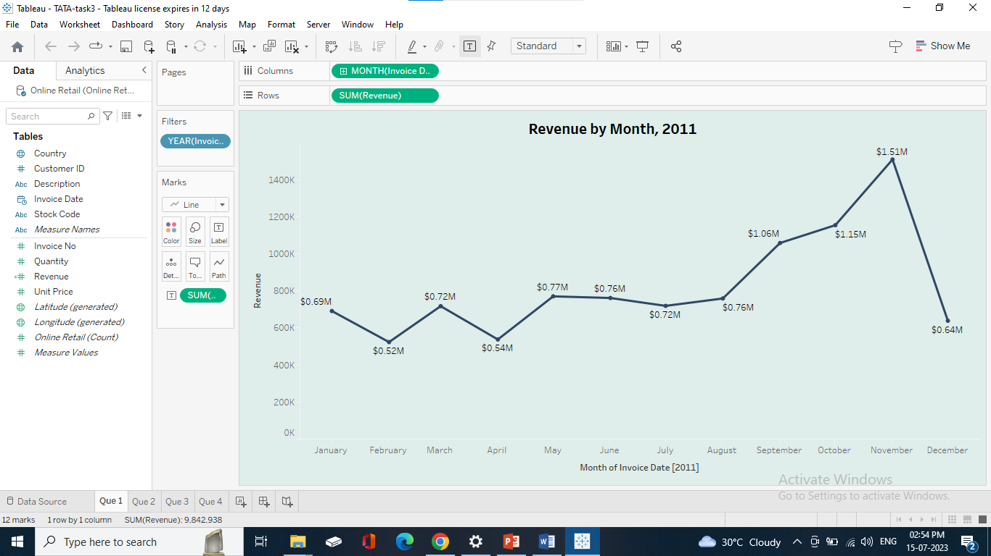
Revenue over the months in 2011
Regarding your first query, the CEO has asked for a revenue trend to determine whether retail sales are seasonal.
According to the statistics, the sales from January to August were very stable, with an average of $685K.
We had a significant increase in revenue from September with the revenue peaking at $1.51 Million in November and an average of 21.18% increase in revenue from August to November.
The revenue trend from August to December demonstrates how seasonality affects retail store sales

Slide 5
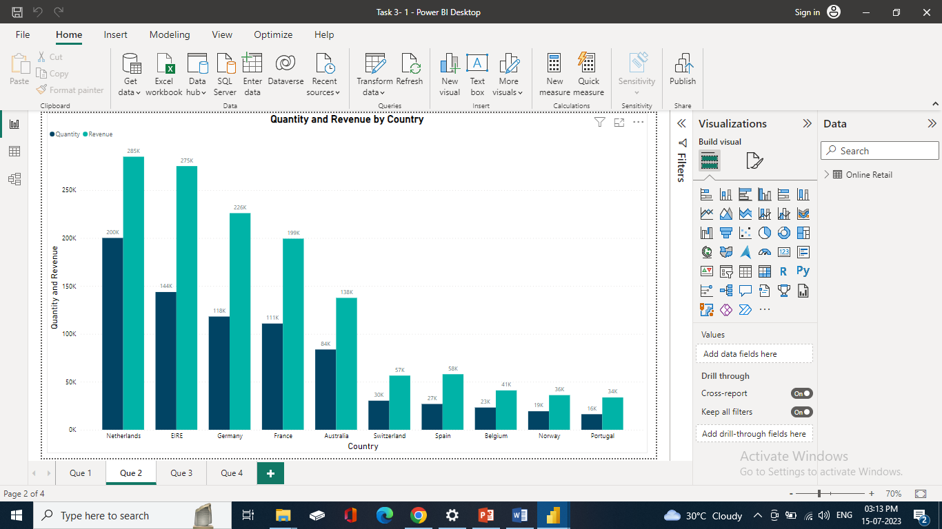
Top 10 Countries by Revenue and Quantity
The top 10 countries with the most potential for growth are represented in the second graph
UK already has a large demand and I understand you are more interested in nations where demand may be boosted, so UK is excluded.
According to the data, sales of units and income are quite high in nations like the Netherlands, Ireland, Germany, and France.
To guarantee that steps are taken to further seize these markets, I would propose concentrating on these nations in terms of marketing strategies.

Slide 6
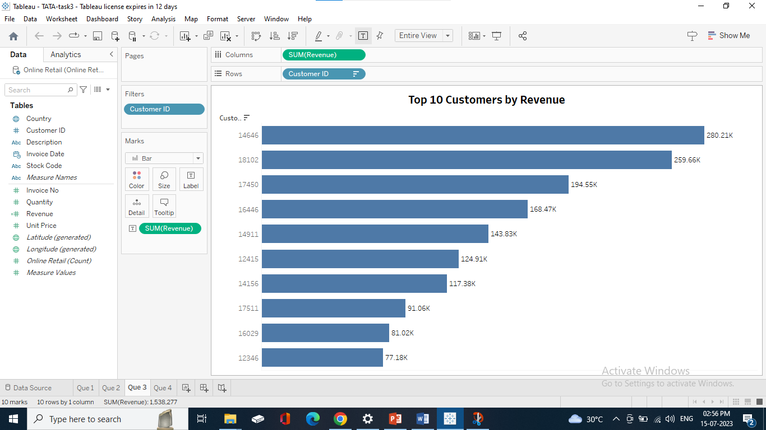
Top 10 Customers by Revenue
The top 10 consumers who have made the most purchases from the business have been the subject of the third study.
The fact that the highest revenue-producing consumer only spent 17% more than the second highest demonstrates that the company does not rely solely on a small number of consumers to generate income.
The average difference in revenue between a top 10 customers is 15.8%. The company can aim to strengthen the relationship with these customers to increase customer loyalty and retention, and ultimately drive more sales and revenue for the company.

Slide 7
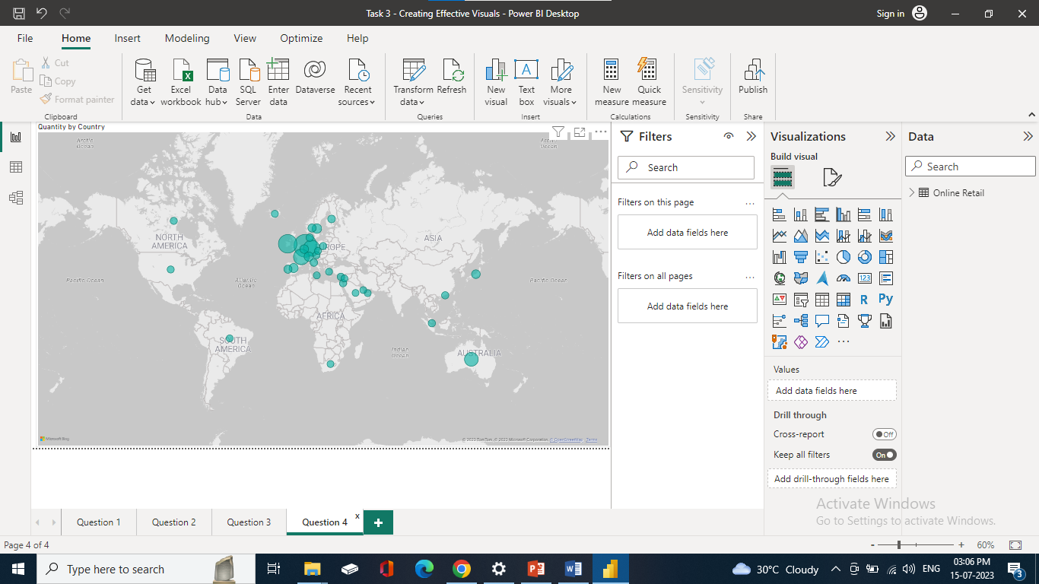
Revenue by Country
The map chart concludes by comparing the places that have produced the greatest revenue to those that have not.
Apart from the UK, it is clear that nations like the Netherlands, Ireland, Germany, France, and Australia generate large profits.
The company can concentrate on European market.
Along with Russia, there is no market for the items in Africa or Asia. Sales revenues and profitability might increase with the implementation of a fresh strategy focused on these areas.

Slide 8
Insights:
The company should come up with strategies that aim at stocking and advertising seasonal products to maximize sales when the demand for these goods goes up.
The company should do a deeper analysis of products that are usually in high demand during low-sales months to come up with strategies for marketing these products.
A deeper dive into the type of products and the revenue generated from these products for each region would be key in guiding region- specific marketing strategies.
The company should consider incentivizing top revenue-generating customers to strengthen the relationship with these customers.
The European Market has more potential for growth and the company should aim at strategies that will increase its market positioning in the region.

Slide 9
THANK YOU !!

